Slide 1


The Role of AI in Enhancing Software Product Capabilities
Artificial Intelligence (AI) is transforming the software industry, empowering developers to create more intelligent, personalized, and efficient products. In this presentation, we'll explore how AI can enhance various aspects of software development and product capabilities.
by prachi hegiste

Slide 2
Introduction to AI and its growing impact
AI Advancements
Transforming Software
Recent breakthroughs in machine learning, natural language processing, and computer vision have significantly expanded the capabilities of AI systems.
AI is revolutionizing how software is designed, developed, and deployed, unlocking new possibilities for enhanced user experiences and operational efficiency.

Slide 3

Enhancing User Experience through AI-Powered Personalization
1
Personalized Recommendations
2
Adaptive Interfaces
AI-driven user interfaces dynamically adapt to individual user needs, creating a more intuitive and seamless experience.
AI algorithms analyze user behavior and preferences to provide tailored product recommendations, improving engagement and satisfaction.

Slide 4
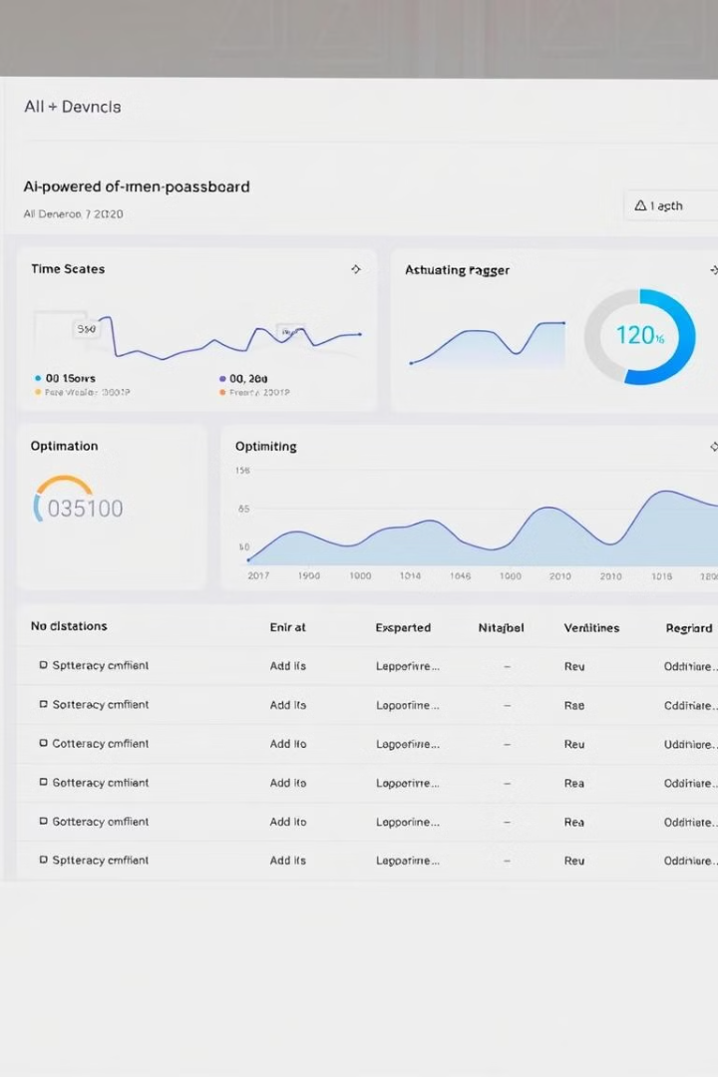
Improving Software Efficiency and Performance
AI-Driven Optimization
Predictive Maintenance
AI algorithms analyze system performance data to identify and resolve bottlenecks, leading to improved speed, scalability, and resource utilization.
AI models predict potential failures and proactively trigger maintenance, reducing downtime and enhancing software reliability.

Slide 5

Leveraging AI for Predictive Maintenance and Anomaly Detection
1
Data Collection
Gather operational data from software systems and components.
2
AI Model Training
Develop machine learning models to identify patterns and predict potential issues.
3
Anomaly Detection
Continuously monitor for deviations from normal behavior and alert teams to take proactive action.

Slide 6




AI-Enabled Automation in Software Development
Code Generation
Test Automation
Workflow Optimization
AI-powered tools can automatically generate code, accelerating development and reducing manual efforts.
AI can automate software testing, improving coverage, speed, and accuracy.
AI can analyze development processes and suggest improvements to boost productivity and efficiency.

Slide 7



Driving Product Innovation with AI
AI-Powered Features
1
Integrating AI capabilities directly into software products, such as intelligent assistants, predictive analytics, and adaptive user interfaces.
Accelerated Development
2
AI tools streamlining and automating various development tasks, allowing teams to focus on product innovation.
Data-Driven Insights
3
AI models analyzing user data to uncover new opportunities and inform product roadmaps.

Slide 8

Addressing Ethical Considerations
Responsible AI Implementation
Privacy and Data Governance
Ensuring AI systems are designed and deployed with transparency, fairness, and accountability to mitigate potential risks and biases.
Establishing robust data privacy and security measures to protect user information and maintain trust in AI-powered software products.

Slide 9

The Future of AI-Enhanced Software
80%
Increased Adoption
By 2025, it's estimated that over 80% of enterprise software will incorporate AI capabilities.
30%
Productivity Boost
AI can increase software development productivity by up to 30%.
10x
Improved Performance
AI-driven optimization can deliver up to 10x improvements in software performance and efficiency.

